Slide 1
CMSC 471
Games : Part 1

Slide 2
Why study games?
Interesting, hard problems requiring minimal “initial structure”
Clear criteria for success
Study problems involving {hostile, adversarial, competing} agents and uncertainty of interacting with the natural world
People have used them to assess their intelligence

Slide 3
Classical vs. Statistical approach
We’ll look first at the classical approach used from the 1940s to 2010
Then at newer statistical approaches, of which AlphaGo is an example
These share some techniques

Slide 4
Typical simple case for a game
2-person game
Players alternate moves
Zero-sum: one player’s loss is the other’s gain
Perfect information: both players have access to complete information about state of game. No information hidden from either player.
No chance (e.g., using dice) involved
Examples: Tic-Tac-Toe, Checkers, Chess, Go, Nim, Othello
But not: Bridge, Solitaire, Backgammon, Poker, Rock-Paper-Scissors, ...

Slide 5
Can we use …
Uninformed search?
Heuristic search?
Local search?
Constraint based search?
None of these model the fact that we have an adversary …

Slide 6
How to play a game
A way to play such a game is to:
Consider all the legal moves you can make
Compute new position resulting from each move
Evaluate each to determine which is best
Make that move
Wait for your opponent to move and repeat
Key problems are:
Representing the “board” (i.e., game state)
Generating all legal next boards
Evaluating a position

Slide 7
Evaluation function
Evaluation function or static evaluator used to evaluate the “goodness” of a game position
Contrast with heuristic search, where evaluation function estimates cost from start node to goal passing through given node
Zero-sum assumption permits single function to describe goodness of board for both players
f(n) >> 0: position n good for me; bad for you
f(n) << 0: position n bad for me; good for you
f(n) near 0: position n is a neutral position
f(n) = +infinity: win for me
f(n) = -infinity: win for you

Slide 8
Evaluation function examples
For Tic-Tac-Toe
f(n) = [# my open 3lengths] - [# your open 3lengths]
Where a 3length is complete row, column or diagonal that has no opponent marks
Alan Turing’s function for chess
f(n) = w(n)/b(n) where w(n) = sum of point value of white’s pieces and b(n) = sum of black’s
Traditional piece values: pawn:1; knight:3; bishop:3; rook:5; queen:9

Slide 9
Evaluation function examples
Most evaluation functions specified as a weighted sum of positive features
f(n) = w₁*feat₁(n) + w₂*feat₂(n) + ... + w_{n}*feat_{k}(n)
Typical chess features are piece count, piece values, piece placement, squares controlled, etc.
IBM’s chess program Deep Blue (circa 1996) had >8K features in its evaluation function

Slide 10
But, that’s not how people play
People also use look ahead
i.e., enumerate actions, consider opponent’s possible responses, REPEAT
Producing a complete game tree is only possible for simple games
So, generate a partial game tree for some number of plys
Move = each player takes a turn
Ply = one player’s turn
What do we do with the game tree?

Slide 11
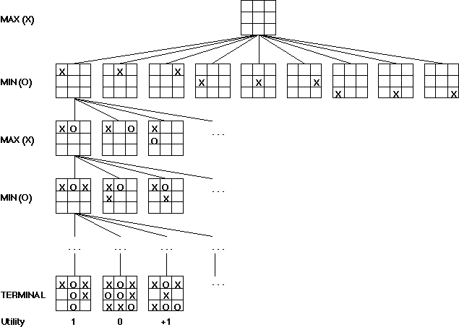
We can easily generate a complete game tree for Tic-Tac-Toe
Taking board symmetries into account, there are 138 terminal positions
91 wins for X, 44 for O and 3 draws

Slide 12
Minimax theorem
Intuition: assume your opponent is at least as smart as you and play accordingly
If she’s not, you can only do better!
You can think of this as:
Minimizing your maximum possible loss
Maximizing your minimum possible gain

Slide 13
Minimax Algorithm
Mini-max algorithm is a recursive or backtracking algorithm that is used in decision-making and game theory.
Mini-Max algorithm uses recursion to search through the game-tree.
In this game, 2-players play the game. One is called MAX. The other is called MIN.

Slide 14
Minimax Algorithm
Both players’ objective is to maximize their benefit and minimize the opponents benefit.
The minimax algorithm performs a DFS for exploration of the complete game tree.
The minimax algorithm proceeds all the way down to the terminal node of the tree, then backtrack the tree as recursion.

Slide 15
Minimax procedure
Create MAX node with current board configuration
Expand nodes to some depth (a.k.a. plys) of lookahead in game
Apply evaluation function at each leaf node
Back up values for each non-leaf node until value is computed for the root node
At MIN nodes: value is minimum of children’s values
At MAX nodes: value is maximum of children’s values
Choose move to child node whose backed-up value determined value at root

Slide 16
Minimax Algorithm
2
7
1
8
Static evaluator value
MAX
MIN

Slide 17
Minimax Algorithm
2
1
2
7
1
8
2
7
1
8
Static evaluator value
MAX
MIN

Slide 18
Minimax Algorithm
2
2
1
2
1
2
7
1
8
2
7
1
8
2
7
1
8
Static evaluator value
MAX
MIN

Slide 19
Minimax Algorithm
2
2
1
2
1
2
7
1
8
2
7
1
8
2
7
1
8
2
Static evaluator value
2
1
MAX
MIN
2
7
1
8

Slide 20
Minimax Algorithm
2
2
1
2
1
2
7
1
8
2
7
1
8
2
7
1
8
This is the move
selected by minimax
2
Static evaluator value
2
1
MAX
MIN
2
7
1
8

Slide 21
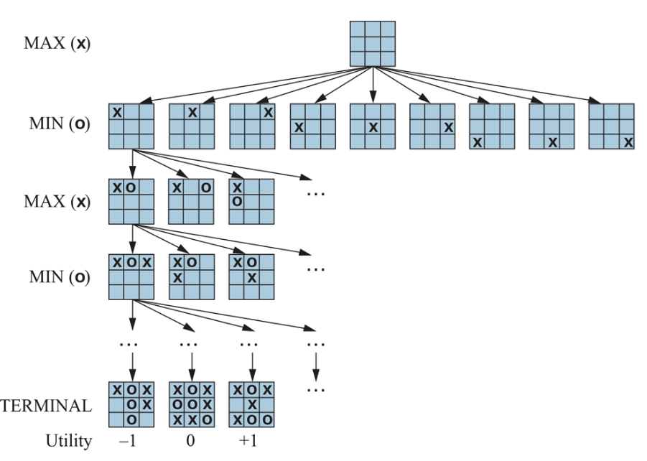
Partial Game Tree for Tic-Tac-Toe
f(n)=+1 if position win for X
f(n)=-1 if position win for O
f(n)=0 if position a draw
Partial game tree for tic-tac-toe. Top node is the initial state, and max moves first, placing an X in an empty square. Only part of the tree shown, giving alternating moves by min (O) and max (X), until we reach terminal states, which are assigned utilities {-1,0,+1} for {loose, draw, win}

Slide 22
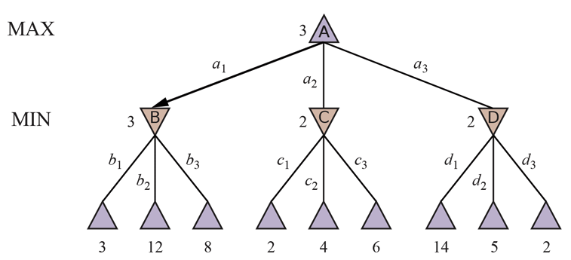
Minimax Tree
MAX node
value computed
by minimax
MIN node
f values:
Two-ply game tree. △ nodes are “max nodes,” in which it is max’s turn to move, and ▽ nodes are “min nodes.” The terminal nodes show utility values for max; the other nodes are labeled with their minimax values. max’s best move at root is a1 because it leads to state with the highest minimax value. min’s best reply is b1 since it leads to the state with the lowest minimax value.

